Slide 1
Case Management REST API
IBM Enterprise Content Management Software
IBM Software Solutions | Enterprise Content Management Software

Slide 2
IBM Case Manager REST services
Browser
Client
HTTP
XML/JSON
Integration Tier - WebSphere Application Server
Process Engine
REST
(PE REST)
Case Management
REST
(Case REST)
Content Management Interoperability Service (CMIS)
Process Engine Java API
Content Engine Java API
P8 Engine
Process
Engine
Content
Engine
Case Manager includes three REST services that are used together to access and manipulate cases

Slide 3
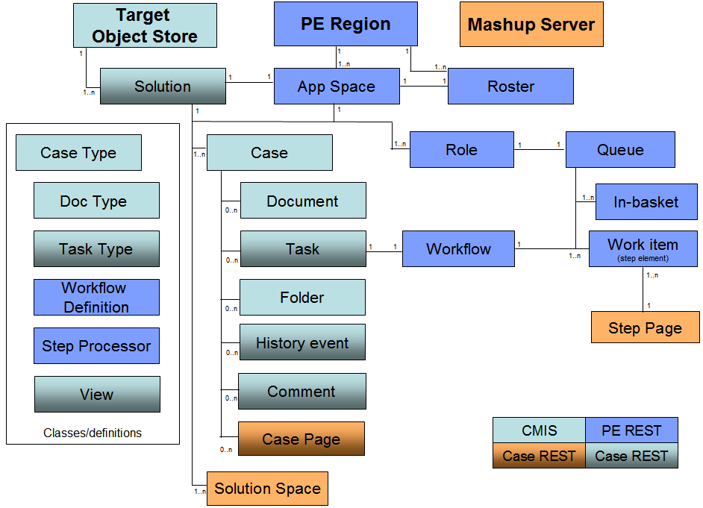
Deployed Solution: focusing here on two-tone boxes
Changes to the above for ICM 5.1:
Case, Case Type, and Doc Type can now be manipulated by Case REST API
Mashup Server is now Business Space
CASE REST API

Slide 4
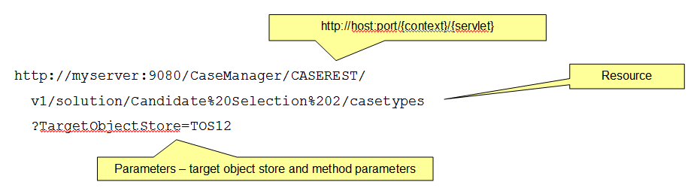
Case REST
URI format:
http://host:port/{context}/CASEREST/v1/{resourceName}[?TargetObjectStore={objectStoreName}][&{resourceParameters}]
JSON returned in response
Example - get list of case types in a solution
CASE REST API

Slide 5

Case REST Example – Get case types in a solution
Request
http://myserver:9080/CaseManager/CASEREST/v1/solution/Candidate%20Selection%202/casetypes?TargetObjectStore=TOS02
Response
{
"CaseTypes":[
{
"CaseType":"CSLM2_Candidate",
"Description":"Candidate for position",
"DisplayName":"Candidate"
},
{
"CaseType":"CSLM2_Interview",
"Description":"Interview for position",
"DisplayName":"Interview"
}
]
}
CASE REST API

Slide 6
Case REST resource summary: new in ICM 5.1
Details on all resources (for ICM 5.1) are available through the various links at:
  http://publib.boulder.ibm.com/infocenter/casemgmt/v5r1m0/index.jsp?topic=/com.ibm.casemgmt.installing.doc/acmdv014.htm
Resource Description
/cases POST – create case
/case/{case folder ID} GET – get case property values
PUT – update case property values
POST – split case
/case/{case folder ID}/status GET – status of case
/case/{case folder ID}/cases GET – related (split) cases
/casetype/{case type name} GET – case type properties
POST – pass context to get properties
/solution/{solution name}/documenttypes GET – document types for solution
/solutions/{solution name} GET – case types for solution
CASE REST API

Slide 7
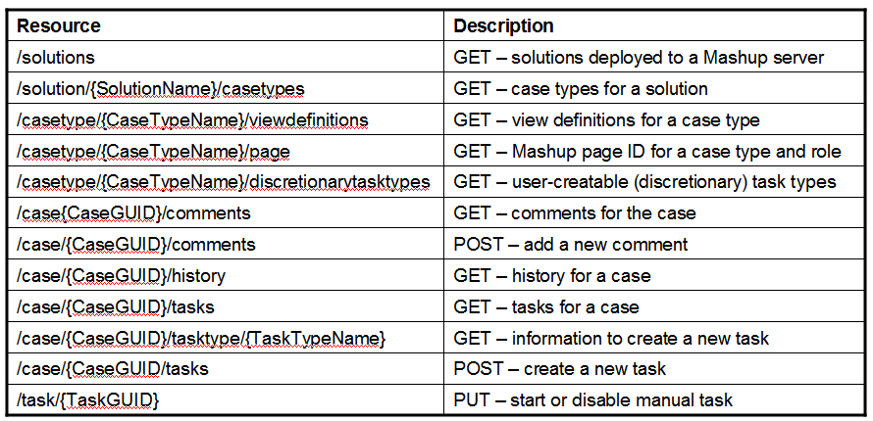
Case REST resource summary: as of ICM 5.0
CaseGUID is the GUID of the case folder for the case
TaskGUID is the GUID of the task instance to be updated
As of ICM 5.1, references here to Mashup now mean Business Space
CASE REST API

Slide 8
Example: List of Deployed Solutions
GET /CASEREST/v1/solutions
{ “Solutions”: [
{
“SolutionName”: “Automobile Claims”,
“Description”: “Solution for processing automobile claims”,
“TargetOS”: “AutomobileClaimsOS”,
“Status”: “Completed”,
“PEConnectionPoint”: “PECP1”
“WebAppID”: “ABC”
}, {
“SolutionName”: “Fire Insurance Claims”,
“Description”: “Solution for processing fire damage”,
“TargetOS”: “FireInsuranceOS”,
“Status”: “Failed”
“PEConnectionPoint”: “PECP1”
“WebAppID”: “XYZ”
}
]
}
CASE REST API

Slide 9
Example: List of Case Types
GET /CASEREST/v1/solution/Auto+Claims/casetypes?TargetObjectStore=MyTOS
HTTP/1.1 200 OK
Content-Type: application/json;charset-UTF-8
{
“CaseTypes”:
[
{
“CaseType”: “AUTO_CollisionClaim”,
“DisplayName”: “Collision Claim”,
“Description”: “process a collision claim”
},
{
“CaseType”: “AUTO_LiabilityClaim”,
“DisplayName” : “Liability Claim”,
“Description”: “process a liability claim”
},
...
]
}
CASE REST API

Slide 10
Example: List of Views
GET /CASEREST/v1/casetype/AUTO_FleetPurchase/viewdefinitions?TargetObjectStore=MyTOS
{ "CaseDataView": {
"Fields": [
{ "FieldType": "property", "Name": "caseName" },
{ "FieldType": "property", "Name": "accountNumber" },
{ "FieldType": "group", "Label": "Home Address", "OpenState": false,
"Fields": [
{"FieldType": “property”, "Name": "StreetAddressLine1"},
{"FieldType": “property”, "Name": "StreetAddressLine2"},
{"FieldType": “property”, "Name": "City"},
{"FieldType": “property”, "Name": "State"},
{"FieldType": “property”, "Name": "ZIPCode"},
] } ] },
"CaseSummaryView": {
"Fields": [
{ "FieldType": "property", "Name": "caseName" },
{ "FieldType": "property", "Name": "customerName" },
{ "FieldType": "property", "Name": "requestedLoanAmount" },
{ "FieldType": "property", "Name": "percentageDown" },
{ "FieldType": "property", "Name": "FicoScore" }
] },
"CaseSearchView": {
//see CaseSummaryView for example } }
CASE REST API

Slide 11
Example: List of User Creatable Tasks
GET /CASEREST/v1/casetype/AUTO_CollisionClaim/discretionarytasktypes?TargetObjectStore=MyTOS
{
"DiscretionaryTaskTypes": [
{
"TaskName": "AC_InvolveRecoveryExpert",
"IsHidden": false,
"HasInstanceCreationRights": true,
"IsContainer": false,
"TaskDisplayName": "Involve Expert",
"Description": "Special request",
"TaskClassId": "{75FD7DF1-EF61-4DF9-98D0-BD40380FDDA9}",
"RequiresLaunchInfo": true
}
}
]
}
CASE REST API

Slide 12
Example: Tasks Instances
GET /CASEREST/v1/case/9E45A997-0E42-406E-AAC4-EE55D8BCF2ED/tasks?TargetObjectStore=MyTOS
{
"Optional":[ {
"RequiredState":0,
"ActivityState":3,
"DisabledState":0,
"LaunchMode":0,
"DateCreated":"2010-07-16T21:50:36Z",
"ActivityId":"{3B5C8E64-43FE-4188-AC72-457A4B8E374C}“,
"ActivityName":“AUTO_ContactCustomer",
"DateLastModified":"2010-07-16T21:50:36Z"}],
"Required":[ {
"RequiredState":1,
"ActivityState":1,
"DisabledState":0,
"LaunchMode":4,
"DateCreated":"2010-07-16T21:50:36Z",
"ActivityId":"{CB3F1916-8D03-44C8-9598-23589D9ED78F}",
"ActivityName":“AUTO_CollectFieldInformation”,
"DateLastModified":"2010-07-16T21:50:36Z"}]
}
CASE REST API

Slide 13
Example: Disable a Task
PUT /CASEREST/v1/task/7A75A997-0E42-406E-AZC4-EE55D7DER9PF?TargetObjectStore=MyTOS
{
“Action”: “disable”
}
{
"RequiredState":0,
"ActivityState":1,
"DisabledState":0,
"ActivityId":"{10F40053-729F-4138-B632-BF920C204DB5}",
"ActivityName":"ETE2 Activity number 2",
"DateLastModified":"2010-07-03T00:50:30Z"
}
CASE REST API

Slide 14
Example: Case Comments (GET)
GET /CASEREST/v1/case/9E45A997-0E42-406E-AAC4-EE55D8BCF2ED/comments?TargetObjectStore=MyTOS&CommentType=Case
{ “Comments”:
[ {
“Id”: “{5E42A997-0F47-446E-AFC4-EE55D8BCF5PP}”,
“Creator”: “Bob”,
“CommentContext”: 101,
“DateCreated”: “2010-04-07T14:30Z”,
“CommentText”: “New request from Bob at GimmeCars.com”
}, {
“Id”: “{9E45A997-0E42-406E-AAC4-EE55D8BCF2EA}”,
“Creator”: “Mary”,
“CommentContext”: 102,
“DateCreated”: “2010-04-07T15:30Z”,
“CommentText”: “Fast-track Bob’s request – very good customer”
}
]
}
CASE REST API

Slide 15
Example: Case Comments (Create)
POST /CASEREST/v1/comment/9E45A997-0E42-406E-AAC4-EE55D8BCF2ED?objectStore=MyTOS&commentType=DOCUMENT
{
“Comment”: “blah blah blah blah blah”
}
HTTP/1.1 200 OK
CASE REST API

Slide 16
Example: Case History
GET /CASEREST/v1/history/12345678-AAAA-BBBB-CCCC-DDDD_12345678?ObjecStore=MyObjecStore&BatchSize=1000&ObjectTypeAndDetail=CaseComment,summary&ObjectTypeAndDetailDocument,detailed&ObjectTypeAndDetail=CaseFolder,detailed
{ “Continuation”: “<opaque continuation string or null string if last batch>”,
“Events”: [ { “EventDateTime”: “2010-06-24T14:33:22.000Z”,
“ClassName”: “Document”,
“AuditEvent”: 7,
# all properties of the event except system properties
“Properties”: [ {
“PropertyName”: “xxx”,
“PropertyValue”: “yyy”
}, {
“PropertyName”: “aaa”,
“PropertyValue”: “bbb”
} ]
}, {
“EventDateTime”: “2010-06-24T14:33:33.001Z”,
“ClassName”: “CmAcmWorkItemComment”,
“AuditEvent”: 9,
“Properties”: [ {
“PropertyName”: “xyz”,
“PropertyValue”: “yzx”,
}, {
“PropertyName”: “abc”,
“PropertyValue”: “cba”
}, ... ] } ...
]
}
CASE REST API

Slide 17
Example: Create a case
POST /CASEREST/v1/cases
{
"CaseType": "AUTO_CollisionClaim",
"TargetObjectStore": "CMTOS",
"ReturnUpdates": false,
"Properties":
[
{
"SymbolicName" : "AUTO_ClaimDate",
"Value" : "2010-07-16T21:50:36Z",
},
{
"SymbolicName" : "AUTO_ClaimStatus",
"Value" : "0",
}
]
}
HTTP 1.1 201 OK Created
Content-Type: application/json;charset-UTF-8
{
"CaseTitle": "DH2_MyCase_000000100402",
"CaseIdentifier": "DH2_MyCase_000000100402",
"CaseFolderId": "{A42BE8EB-848F-4CBD-B2F7-64FAF2CE7081}"
}
CASE REST API

Slide 18
Example: Update case properties
PUT /CASEREST/v1/case/C5AB1E9D-30D1-4D21-ADDF-F248FF1354B7
{
"TargetObjectStore":"CMTOSSH",
"Properties":
[
{"SymbolicName":"DH2_State","Value":"NV"},
{"SymbolicName":"DH2_PropOne","Value":8},
{"SymbolicName":"DH2_City","Value":"Reno"},
{"SymbolicName":"DH2_MVInt","Value":[0,101,300,340]},
{"SymbolicName":"DH2_MVString","Value":["One","Three","Sixty"]}
]
}
CASE REST API

Slide 19
Example: Get case status
GET /CASEREST/v1/case/9E45A997-0E42-406E-AAC4-EE55D8BCF2ED/status
?TargetObjectStore=CMTOS
{
"Status": "Working",
"CaseIdentifier":"MY_Case_000000100105",
"DateCreated":" 2010-07-16T21:50:36Z",
"DateLastModified":"2010-07-16T21:50:36Z"
}
CASE REST API

Slide 20
Example: Create case relationship
POST /CASEREST/v1/case/9E45A997-0E42-406E-AAC4-EE55D8BCF2ED
{
"CaseType": "My_casetype",
"TargetObjectStore": "myTargetOS",
"Operation": "relate",
"CaseFolderId": "{12345678-1234-1234-1234-aabbccddeeff}",
"OperationDescription": "description of operation",
"RelationshipCategory": "category name",
"TwoWayRelationship": "true"
}
CASE REST API

Slide 21
Example: Get related cases
GET /CASEREST/v1/case/9E45A997-0E42-406E-AAC4-EE55D8BCF2ED/cases
?TargetObjectStore=MyExampleObjectStore
[
{
"Status": "Working",
"CaseTitle": "MY_Case_000000100105",
"CaseIdentifier": "MY_Case_000000100105",
"CaseFolderId": "1D56A997-0E42-406E-AAC4-EE55D8BCF2ED",
"DateCreated": " 2010-07-16T21:50:36Z",
"Creator": "Admin",
"RelationshipType": "split source",
"RelationshipId": "{12345678-1234-1234-1234-aabbccddeeff}"
},
{
"Status": "Working",
"CaseTitle": "MyCaseTitle",
"CaseIdentifier": "MY_Case_000000100106",
"CaseFolderId": "2E67A997-0E42-406E-AAC4-EE55D8BCF2ED",
"DateCreated": " 2010-07-16T21:50:36Z",
"Creator": "Admin",
"RelationshipType": "split target",
"RelationshipID": "{22345678-1234-1234-1234-aabbccddeeff"
}
}
]
CASE REST API

